Slide 1
Online Photoghrapher Hiring System
Prepared By:
Manish Desai
240160510008

Slide 2
Introduction
Looking for the perfect photographer for your event? Whether it’s a wedding, birthday, corporate event, or any special occasion, makes it easy to find and hire professional photographers online.
With just a few clicks, you can browse profiles, check availability, view portfolios, and book a photographer that fits your style and budget.

Slide 3
Existing system
Many current platforms have high pricing without clear breakdowns, making it hard for users to know if they’re getting a good deal. These systems are often not user-friendly, which makes booking a photographer confusing or time-consuming.
Also, users usually don’t get to see the actual photos that were delivered to previous clients – they only see the ones the photographer chooses to post. This makes it hard to decide which photographer is truly the best for their event.

Slide 4
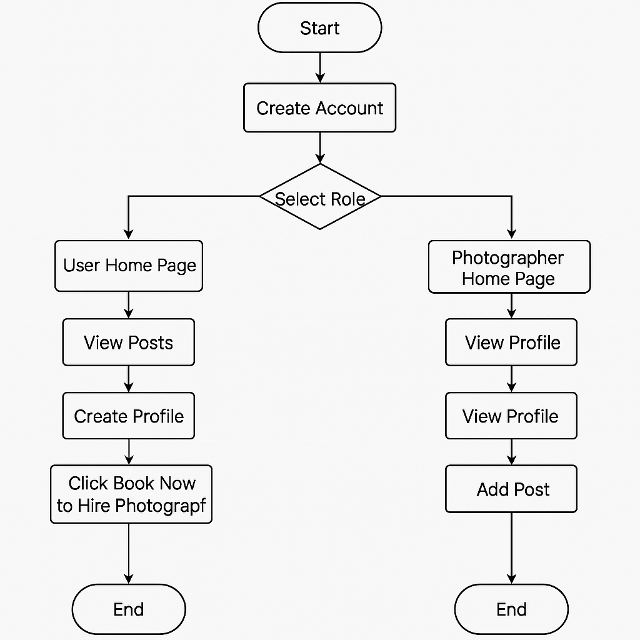
Activity diagram (whole system)

Slide 5
Er diagram (current system)
User
Post
Receive
Post

Slide 6
New system
The new system aims to make getting medicines from the store safer and more reliable.
Now, before anyone gets their medicines, the store owner arranges for the person meet a doctor.
The doctor talks to them and figures out what medication they need.
This makes sure they get the right medicines for their health
Doctor give prescription to the customer as per their need.
Customer take the prescription and gave it to the medical store owner and then they take the medicine and pay both doctor and the medical store owner

Slide 7
Dataflow diagram : context level
Customer
Medical Store Owner
Doctor
Medicine dispense
Arrange meeting
Receive payment
Request Medicine
(have prescription or not)
Medical prescription System
Join meeting
Join meeting
Receives medicines
Give consultation and
Provide prescription
Payment
Receive payment

Slide 8
Dataflow diagram 1 level
Dispense medicine
Request medicine
dispense medicine
Customer
Medical store owner
Medicine
Arrange meeting
Medicine
data
Payment to
medical store owner
medicine_data
Payment
Meeting
Request
for join
meeting
Join
meeting
Payment to doctor
Doctor
Doctor data
doctor_data
Give consultation
Consultation
Join meeting

Slide 9
Use case
Medical prescription system
Request medicine
Provide prescription
Medical Store Owner
Arrange meeting
Customer
Join meeting
Dispense medicine
Doctor
Payment

Slide 10
Data dictionary
meicine_data
medicine_id
medicine_name
mfg_date
exp_date
meicine_data:
It stores the all detail about medicine like medicine id, name, mfg date, exp date and price.
doctor_data:
It store the doctor data like doctor id, name of doctor, type of the doctor and the fee of doctor

Slide 11
Thank you

